Slide 1
Linear Regression
Dr Mehrdad Ghaziasgar

Slide 2
Content – Part 1
Simple (Univariate) Linear Regression
Model Representation
Cost Function
Gradient Descent
Formulation
Algorithm
Application to Linear Regression

Slide 3
Simple Linear Regression
Model Representation
Simple (Univariate) Linear Regression
Model Representation
Cost Function
Gradient Descent
Formulation
Algorithm
Application to Linear Regression

Slide 4
Model Representation - Introduction
Running example: predicting housing prices
We obtain information about:
Houses e.g. size (sq. metres), no. of bedrooms, no. of bathrooms, no. of garages, frontage (metres), no. of storeys, garden size (sq. metres) etc. etc.
Price that each house last (recently) sold for
Use a learning algorithm to build a model to predict housing prices
Simple Linear Regression

Slide 5
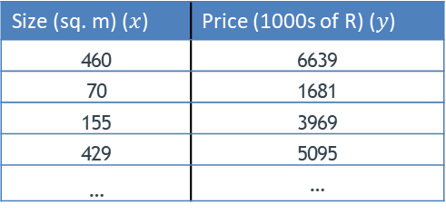
Model Representation - Introduction
Size (sq. m) ($x$) | Price (1000s of R) ($y$)
460 | 6639
70 | 1681
155 | 3969
429 | 5095
… | …
Simple Linear Regression
Training set of house sizes and prices
We obtain the data above

Slide 6
Model Representation - Introduction
Supervised learning:
Given the “right” answer for each data point
Regression:
Predict a real-valued (continuous) output e.g. price
(Side note: the other branch of supervised learning is classification i.e. predict discrete output e.g. category)
Simple Linear Regression

Slide 7
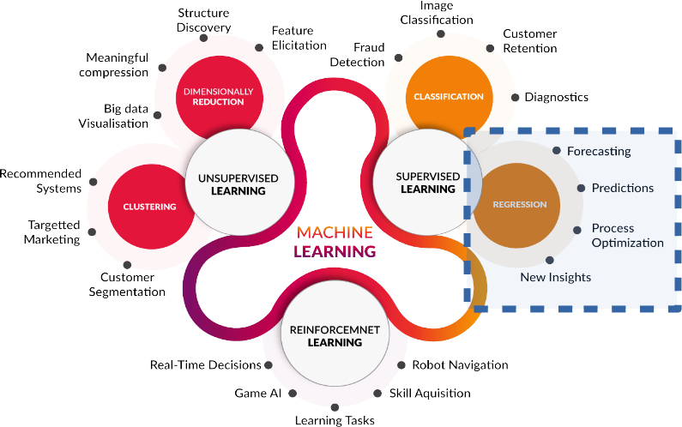
Model Representation - Introduction
Simple Linear Regression

Slide 8
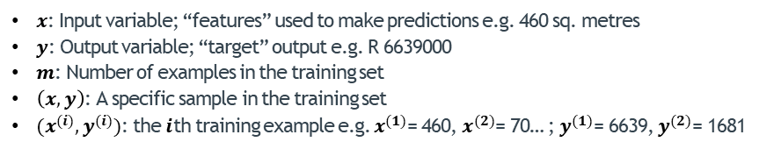
Model Representation - Notation
Size (sq. m) ($x$) | Price (1000s of R) ($y$)
460 | 6639
70 | 1681
155 | 3969
429 | 5095
… | …
Simple Linear Regression
Training set of house sizes and prices
$x$: Input variable; “features” used to make predictions e.g. 460 sq. metres
$y$: Output variable; “target” output e.g. R 6639000
$m$: Number of examples in the training set
$\left(x,y\right)$: A specific sample in the training set
$(x^{(i)},y^{(i)})$: the $i$th training example e.g. $x^{(1)}$= 460, $x^{(2)}$= 70… ; $y^{(1)}$= 6639, $y^{(2)}$= 1681

Slide 9
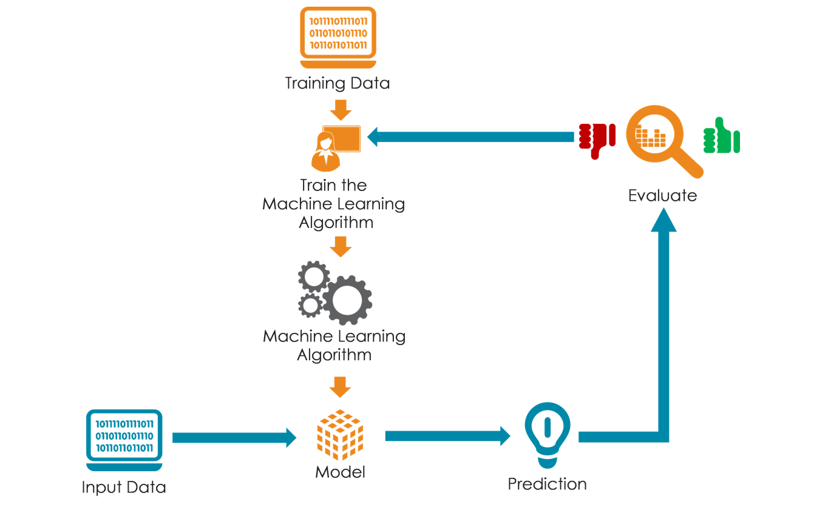
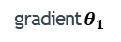

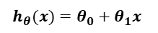
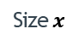
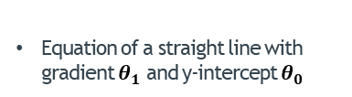
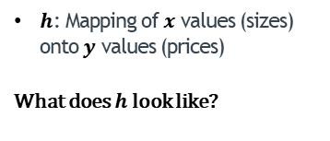
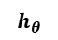
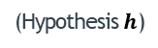
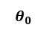
Model Representation – Project Design
$h$: Mapping of $x$ values (sizes) onto $y$ values (prices)
What does $h$ look like?
$$h_{θ}$$
Simple Linear Regression
Price $y$
gradient $θ_{1}$
$$θ_{0}$$
Size $x$
$$h_{θ}(x)=θ_{0}+θ_{1}x$$
Equation of a straight line with gradient $θ_{1}$ and y-intercept $θ_{0}$
(Hypothesis $h$)
(House size)
(Estimated house price)

Slide 10
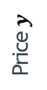
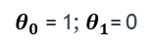
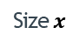
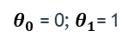

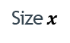
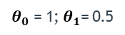
Model Representation - Deciphering${ h}_{θ}(x)$
3
3
3
2
2
2
Price $y$
Price $y$
Price $y$
1
1
1
Simple Linear Regression
1
2
3
1
2
3
1
2
3
Size $x$
Size $x$
Size $x$
$θ_{0}$ = 1; $θ_{1}$= 0
$θ_{0}$ = 0; $θ_{1}$= 1
$θ_{0}$ = 1; $θ_{1}$= 0.5
$$h_{θ}(x)=θ_{0}+θ_{1}x$$

Slide 11
Model Representation - Deciphering${ h}_{θ}(x)$
Simple Linear Regression

Slide 12
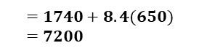
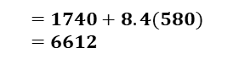
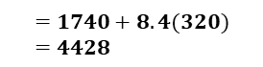
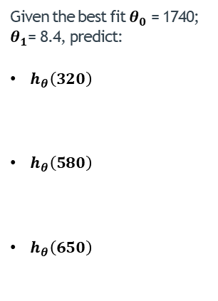
Model Representation - Using${ h}_{θ}(x)$ to Make Predictions
Given the best fit $θ_{0}$ = 1740; $θ_{1}$= 8.4, predict:
$h_{θ}\left(320\right)$
$h_{θ}\left(580\right)$
$h_{θ}\left(650\right)$
Simple Linear Regression
$$=1740+8.4(320)=4428$$
$$=1740+8.4(580)=6612$$
320
580
650
$$=1740+8.4(650)=7200$$

Slide 13
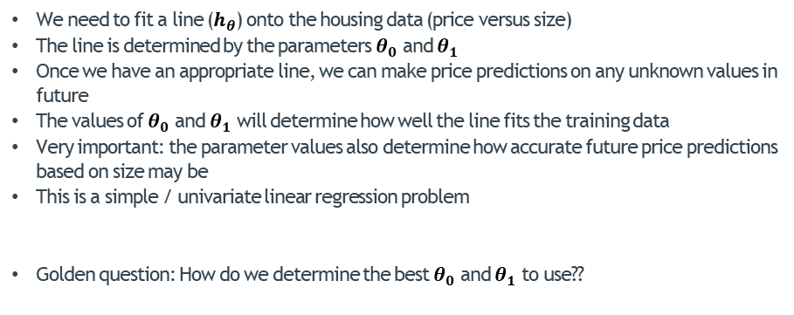
Model Representation - Summary
We need to fit a line ($h_{θ}$) onto the housing data (price versus size)
The line is determined by the parameters $θ_{0}$ and $θ_{1}$
Once we have an appropriate line, we can make price predictions on any unknown values in future
The values of $θ_{0}$ and $θ_{1}$ will determine how well the line fits the training data
Very important: the parameter values also determine how accurate future price predictions based on size may be
This is a simple / univariate linear regression problem
Golden question: How do we determine the best $θ_{0}$ and $θ_{1}$ to use??
Simple Linear Regression

Slide 14
Simple Linear Regression
Cost Function
Simple (Univariate) Linear Regression
Model Representation
Cost Function
Gradient Descent
Formulation
Algorithm
Application to Linear Regression

Slide 15
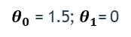
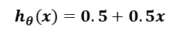
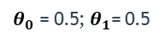
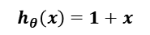
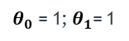

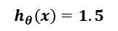
Cost Function - Formulation
3
3
3
2
2
2
Price $y$
Price $y$
Price $y$
1
1
1
Simple Linear Regression
1
2
3
1
2
3
1
2
3
Size $x$
Size $x$
Size $x$
$θ_{0}$ = 1.5; $θ_{1}$= 0
$θ_{0}$ = 1; $θ_{1}$= 1
$θ_{0}$ = 0.5; $θ_{1}$= 0.5
$$h_{θ}\left(x\right)=1.5$$
$$h_{θ}\left(x\right)=1+x$$
$$h_{θ}\left(x\right)=0.5+0.5x$$
Given the points in the training set $\left(x,y\right)$, choose $θ_{0}$ and $θ_{1}$ such that the line’s predicted prices ($h_{θ}\left(x\right)$) are “close” to the each actual price ($y$)

Slide 16
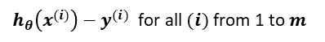
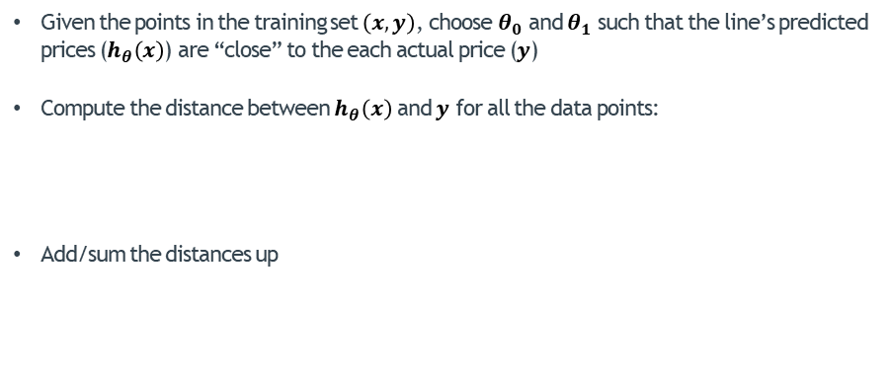
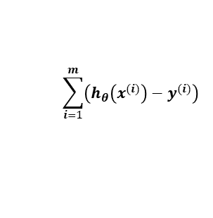
Cost Function - Formulation
Given the points in the training set $\left(x,y\right)$, choose $θ_{0}$ and $θ_{1}$ such that the line’s predicted prices ($h_{θ}\left(x\right)$) are “close” to the each actual price ($y$)
Compute the distance between $h_{θ}\left(x\right)$ and $y$ for all the data points:
Add/sum the distances up
Simple Linear Regression
$h_{θ}\left(x^{(i)}\right)−y^{(i)}$ for all $(i)$ from 1 to $m$
$$\sum_{i=1}^{m}{{\left(h_{θ}\left(x^{(i)}\right)−y^{(i)}\right)}^{}}$$

Slide 17
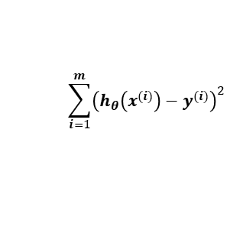
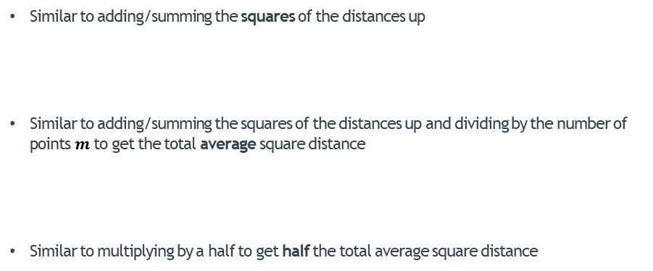
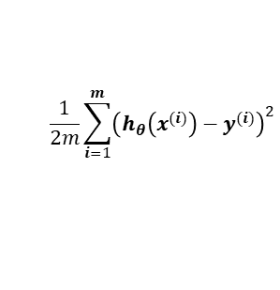
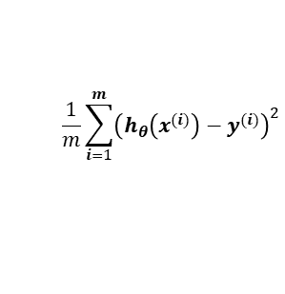
Cost Function - Formulation
Similar to adding/summing the squares of the distances up
Similar to adding/summing the squares of the distances up and dividing by the number of points $m$ to get the total average square distance
Similar to multiplying by a half to get half the total average square distance
$$\sum_{i=1}^{m}{{\left(h_{θ}\left(x^{(i)}\right)−y^{(i)}\right)}^{2}}$$
Simple Linear Regression
$$\frac{1}{m}\sum_{i=1}^{m}{{\left(h_{θ}\left(x^{(i)}\right)−y^{(i)}\right)}^{2}}$$
$$\frac{1}{2m}\sum_{i=1}^{m}{{\left(h_{θ}\left(x^{(i)}\right)−y^{(i)}\right)}^{2}}$$
The smaller this is, the better the line fits
The larger this is, the worse the line fits
This is the “cost function”

Slide 18
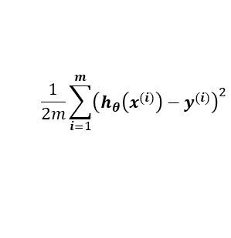
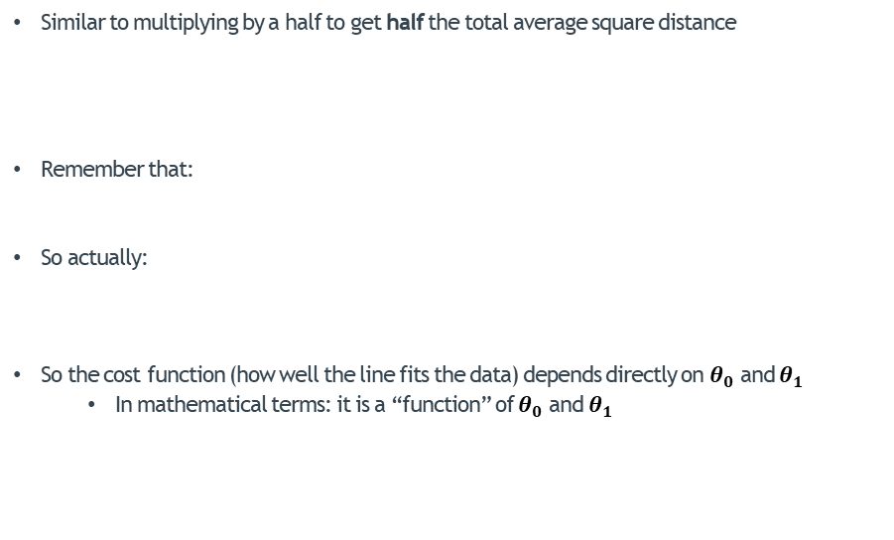
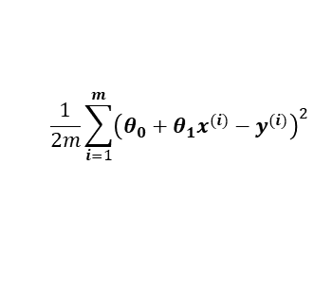
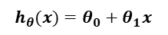
Cost Function - Formulation
Similar to multiplying by a half to get half the total average square distance
Remember that:
So actually:
So the cost function (how well the line fits the data) depends directly on $θ_{0}$ and $θ_{1}$
In mathematical terms: it is a “function” of $θ_{0}$ and $θ_{1}$
$$\frac{1}{2m}\sum_{i=1}^{m}{{\left(h_{θ}\left(x^{(i)}\right)−y^{(i)}\right)}^{2}}$$
The smaller this is, the better the line fits
The larger this is, the worse the line fits
This is the “cost function”
Simple Linear Regression
$$h_{θ}(x)=θ_{0}+θ_{1}x$$
$$\frac{1}{2m}\sum_{i=1}^{m}{{\left(θ_{0}+θ_{1}x^{(i)}−y^{(i)}\right)}^{2}}$$

Slide 19
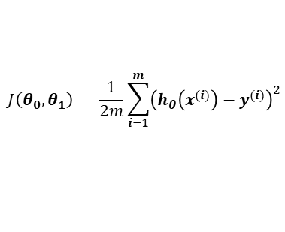
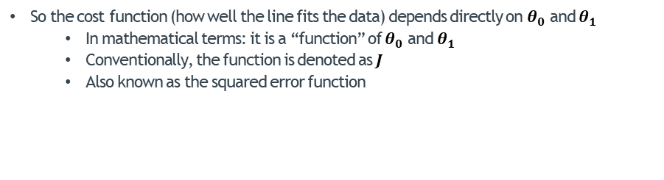
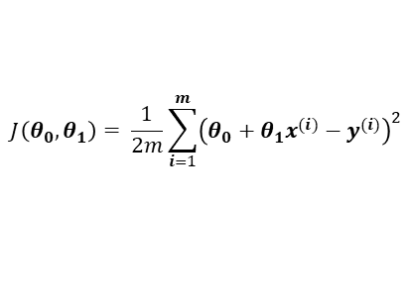
Cost Function - Formulation
So the cost function (how well the line fits the data) depends directly on $θ_{0}$ and $θ_{1}$
In mathematical terms: it is a “function” of $θ_{0}$ and $θ_{1}$
Conventionally, the function is denoted as $J$
Also known as the squared error function
$$J\left(θ_{0},θ_{1}\right)= \frac{1}{2m}\sum_{i=1}^{m}{{\left(h_{θ}\left(x^{(i)}\right)−y^{(i)}\right)}^{2}}$$
Simple Linear Regression
or
$$J\left(θ_{0},θ_{1}\right)= \frac{1}{2m}\sum_{i=1}^{m}{{\left(θ_{0}+θ_{1}x^{(i)}−y^{(i)}\right)}^{2}}$$

Slide 20
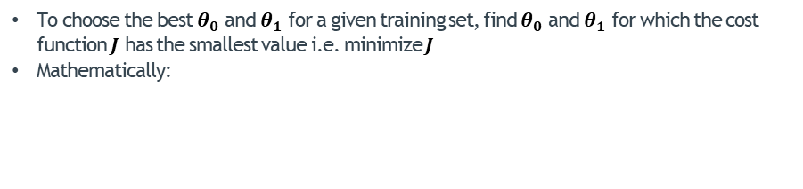
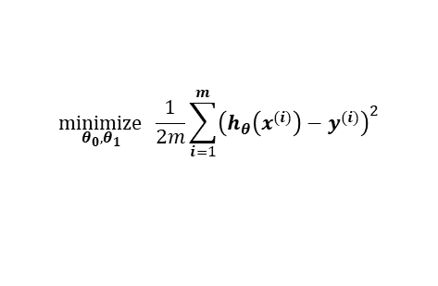
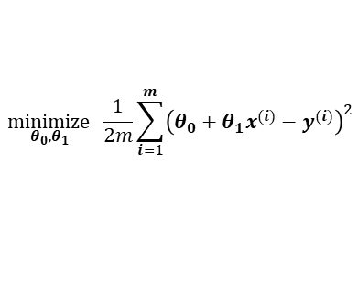
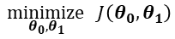
Cost Function - Formulation
To choose the best $θ_{0}$ and $θ_{1}$ for a given training set, find $θ_{0}$ and $θ_{1}$ for which the cost function $J$ has the smallest value i.e. minimize $J$
Mathematically:
$$\underset{θ_{0},θ_{1}}{minimize}{J\left(θ_{0},θ_{1}\right)}$$
Simple Linear Regression
or
$$\underset{θ_{0},θ_{1}}{minimize} \frac{1}{2m}\sum_{i=1}^{m}{{\left(h_{θ}\left(x^{(i)}\right)−y^{(i)}\right)}^{2}}$$
or
$$\underset{θ_{0},θ_{1}}{minimize} \frac{1}{2m}\sum_{i=1}^{m}{{\left(θ_{0}+θ_{1}x^{(i)}−y^{(i)}\right)}^{2}}$$

Slide 21
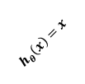
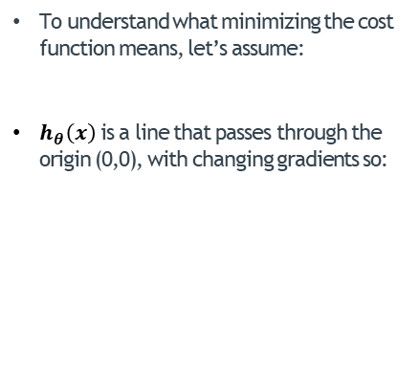
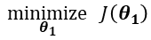







Cost Function - Deciphering the Cost Function $J$
To understand what minimizing the cost function means, let’s assume:
$h_{θ}\left(x\right)$ is a line that passes through the origin (0,0), with changing gradients so:
Therefore the cost function now only depends on $θ_{1}$:
$θ_{0}$ = 0
$$\underset{θ_{1}}{minimize}{J\left(θ_{1}\right)}$$
$$\underset{θ_{1}}{minimize} \frac{1}{2m}\sum_{i=1}^{m}{{\left(h_{θ}\left(x^{(i)}\right)−y^{(i)}\right)}^{2}}$$
Simple Linear Regression
$$h_{θ}\left(x\right)=θ_{1}x$$
3
$$\underset{θ_{1}}{minimize} \frac{1}{2m}\sum_{i=1}^{m}{{\left(θ_{1}x^{(i)}−y^{(i)}\right)}^{2}}$$
$$h_{θ}\left(x\right)=3x$$
2
$$h_{θ}\left(x\right)=x$$
Price $y$
$$h_{θ}\left(x\right)=0.5x$$
1
1
2
3
Size $x$

Slide 22
















Cost Function - Deciphering the Cost Function $J$
6
3
5
2.5
4
2
Price $y$
$${J(θ}_{1})$$
3
1.5
Simple Linear Regression
2
1
1
0.5
1
2
3
4
5
6
0
0.5
1
1.5
2
2.5
3
Size $x$
$$θ_{1}$$
$θ_{1}$= 2
$${J(θ}_{1})= \frac{1}{2m}\sum_{i=1}^{m}{{\left(θ_{1}x^{(i)}−y^{(i)}\right)}^{2}}$$
$θ_{1}$= 1.5
$θ_{1}$= 1
$θ_{1}$= 0
$θ_{1}$= 0.5
$$h_{θ}\left(x\right)=1.5x$$
$$h_{θ}\left(x\right)=2x$$
$$h_{θ}\left(x\right)=x$$
$$h_{θ}\left(x\right)=0$$
$$h_{θ}\left(x\right)=0.5x$$
($θ_{0}$ = 0)

Slide 23









Cost Function - Deciphering the Cost Function $J$ With Two Params
To understand what minimizing the cost function means, now let’s take the original cost function :
An arbitrary line with any gradient and y-intercept so:
The cost function depends on both $θ_{0}$ and ${ θ}_{1}$:
$$J\left(θ_{0},θ_{1}\right)$$
$$\underset{θ_{0},θ_{1}}{minimize}{J\left(θ_{0},θ_{1}\right)}$$
$$\underset{θ_{0},θ_{1}}{minimize} \frac{1}{2m}\sum_{i=1}^{m}{{\left(h_{θ}\left(x^{(i)}\right)−y^{(i)}\right)}^{2}}$$
Simple Linear Regression
$$h_{θ}\left(x\right)=0+3x$$
$$h_{θ}\left(x\right)=2+0.333x$$
3
$$h_{θ}\left(x\right)=θ_{0}+θ_{1}x$$
$$\underset{{θ_{0},θ}_{1}}{minimize} \frac{1}{2m}\sum_{i=1}^{m}{{\left({θ_{0}+θ}_{1}x^{(i)}−y^{(i)}\right)}^{2}}$$
2
Price $y$
1
$$h_{θ}\left(x\right)=1 −0.333x$$
1
2
3
Size $x$

Slide 24



Cost Function - Deciphering the Cost Function $J$ With Two Params
The cost function is a 3D bowl-shaped surface:
6
5
4
Price $y$
Simple Linear Regression
3
2
1
1
2
3
4
5
6
Size $x$
$$J\left(θ_{0},θ_{1}\right)= \frac{1}{2m}\sum_{i=1}^{m}{{\left(θ_{0}+θ_{1}x^{(i)}−y^{(i)}\right)}^{2}}$$
$$h_{θ}\left(x\right)=θ_{0}+θ_{1}x$$

Slide 25

Cost Function - Deciphering the Cost Function $J$ With Two Params
The cost function as a contour plot:
6
5
4
Price $y$
Simple Linear Regression
3
2
1
1
2
3
4
5
6
Size $x$
$$J\left(θ_{0},θ_{1}\right)= \frac{1}{2m}\sum_{i=1}^{m}{{\left(θ_{0}+θ_{1}x^{(i)}−y^{(i)}\right)}^{2}}$$
$$h_{θ}\left(x\right)=θ_{0}+θ_{1}x$$

Slide 26



Cost Function - Deciphering the Cost Function $J$ With Two Params
Given this cost, what’s the hypothesis?
Given this hypothesis, what’s the cost?
Simple Linear Regression
$$J\left(θ_{0},θ_{1}\right)= \frac{1}{2m}\sum_{i=1}^{m}{{\left(θ_{0}+θ_{1}x^{(i)}−y^{(i)}\right)}^{2}}$$
$$h_{θ}\left(x\right)=θ_{0}+θ_{1}x$$

Slide 27
Gradient Descent
Formulation
Simple (Univariate) Linear Regression
Model Representation
Cost Function
Gradient Descent
Formulation
Algorithm
Application to Linear Regression

Slide 28

Formulation - Introduction
How would you go about reaching the minimum (water) below?
Gradient Descent

Slide 29



Formulation - Minimizing the Cost Function
Given some arbitrary cost function $J\left(θ_{0},θ_{1}\right)$
We want to achieve:
Strategy:
Initialize $θ_{0},θ_{1}$ to some random values
Continuously make updates to $θ_{0}$ and $θ_{1}$ in the direction of “descent”
Until the minimum is reached
Gradient Descent
$$\underset{θ_{0},θ_{1}}{minimize}{J\left(θ_{0},θ_{1}\right)}$$

Slide 30


Formulation - Minimizing the Cost Function
Starting at $θ_{0}=0.7$ and $θ_{1}=0.4$
Always move towards steepest descent
Gradient Descent

Slide 31

Formulation - Minimizing the Cost Function
Starting at $θ_{0}=0.67$ and $θ_{1}=0.43$
Always move towards steepest descent
Gradient Descent

Slide 32

Formulation - Gradient Descent With One Parameter
To show you how to formulate gradient descent, let’s again assume:
$h_{θ}\left(x\right)$ is a line that passes through the origin (0,0), with changing gradients so:
Therefore the cost function now only depends on $θ_{1}$:
$θ_{0}$ = 0
$$\underset{θ_{1}}{minimize}{J\left(θ_{1}\right)}$$
$$\underset{θ_{1}}{minimize} \frac{1}{2m}\sum_{i=1}^{m}{{\left(h_{θ}\left(x^{(i)}\right)−y^{(i)}\right)}^{2}}$$
Gradient Descent
$$h_{θ}\left(x\right)=θ_{1}x$$
3
$$\underset{θ_{1}}{minimize} \frac{1}{2m}\sum_{i=1}^{m}{{\left(θ_{1}x^{(i)}−y^{(i)}\right)}^{2}}$$
$$h_{θ}\left(x\right)=3x$$
2
$$h_{θ}\left(x\right)=x$$
Price $y$
$$h_{θ}\left(x\right)=0.5x$$
1
1
2
3
Size $x$

Slide 33



Formulation - Gradient Descent With One Parameter
Slope:
large
negative
Slope:
large
positive
$${J(θ}_{1})$$
Gradient Descent
Slope:
moderate
negative
Slope:
moderate
positive
Slope:
small
negative
Slope:
small
positive
Slope: zero
$$θ_{1}$$

Slide 34


Formulation - Gradient Descent With One Parameter
Subtract $θ_{1}$ by
a large positive number
$$θ_{1}$$
Slope:
large
negative
Slope:
large
positive
$${J(θ}_{1})$$
Gradient Descent
Slope:
moderate
negative
Slope:
moderate
positive
Slope:
small
negative
Slope:
small
positive
Slope: zero
$$θ_{1}$$

Slide 35


Formulation - Gradient Descent With One Parameter
Slope:
large
negative
Slope:
large
positive
$${J(θ}_{1})$$
Gradient Descent
Subtract $θ_{1}$ by
a moderate positive number
$$θ_{1}$$
Slope:
moderate
negative
Slope:
moderate
positive
Slope:
small
negative
Slope:
small
positive
Slope: zero
$$θ_{1}$$

Slide 36

Formulation - Gradient Descent With One Parameter
Slope:
large
negative
Slope:
large
positive
$${J(θ}_{1})$$
Gradient Descent
Subtract $θ_{1}$ by
a small positive number
$$θ_{1}$$
Slope:
moderate
negative
Slope:
moderate
positive
Slope:
small
negative
Slope:
small
positive
Slope: zero
$$θ_{1}$$

Slide 37
Formulation - Gradient Descent With One Parameter
Slope:
large
negative
Slope:
large
positive
$${J(θ}_{1})$$
Gradient Descent
What about now?
$$θ_{1}$$
Slope:
moderate
negative
Slope:
moderate
positive
Slope:
small
negative
Slope:
small
positive
Slope: zero
$$θ_{1}$$

Slide 38

Formulation - Gradient Descent With One Parameter
Slope:
large
negative
Slope:
large
positive
$${J(θ}_{1})$$
Gradient Descent
No change to $θ_{1}$
We’ve found the minimum. We’re done.
$$θ_{1}$$
Slope:
moderate
negative
Slope:
moderate
positive
Slope:
small
negative
Slope:
small
positive
Slope: zero
$$θ_{1}$$

Slide 39

Formulation - Gradient Descent With One Parameter
Subtract $θ_{1}$ by
a large negative number
$$θ_{1}$$
Slope:
large
negative
Slope:
large
positive
$${J(θ}_{1})$$
Gradient Descent
Slope:
moderate
negative
Slope:
moderate
positive
Slope:
small
negative
Slope:
small
positive
Slope: zero
$$θ_{1}$$

Slide 40


Formulation - Gradient Descent With One Parameter
Slope:
large
negative
Slope:
large
positive
$${J(θ}_{1})$$
Gradient Descent
Subtract $θ_{1}$ by
a moderate negative number
$$θ_{1}$$
Slope:
moderate
negative
Slope:
moderate
positive
Slope:
small
negative
Slope:
small
positive
Slope: zero
$$θ_{1}$$

Slide 41

Formulation - Gradient Descent With One Parameter
Slope:
large
negative
Slope:
large
positive
$${J(θ}_{1})$$
Gradient Descent
Subtract $θ_{1}$ by
a small negative number
$$θ_{1}$$
Slope:
moderate
negative
Slope:
moderate
positive
Slope:
small
negative
Slope:
small
positive
Slope: zero
$$θ_{1}$$

Slide 42
Gradient Descent
Algorithm
Simple (Univariate) Linear Regression
Model Representation
Cost Function
Gradient Descent
Formulation
Algorithm
Application to Linear Regression

Slide 43


Algorithm - Gradient Descent With One Parameter
For a cost function $J\left(θ_{1}\right)$ :
Repeat until convergence:
Update $θ_{1}$:
$θ_{1}← θ_{1}− α \frac{d}{dθ_{1}}J\left(θ_{1}\right)$
Gradient Descent
Learning rate
Slope

Slide 44




Algorithm – Deciphering Learning Rate
With no learning rate:
No learning rate: no controls on convergence
Could be too slow
Could be too fast
Learning rate is very cost-function specific
In this case:
Too slow
20 steps to convergence
$$θ_{1}← θ_{1}− \frac{d}{dθ_{1}}J\left(θ_{1}\right)$$
Gradient Descent
$${J(θ}_{1})$$
$$θ_{1}$$

Slide 45



Algorithm – Deciphering Learning Rate
With appropriate learning rate e.g. $α$ = 1.5 :
fast(er) convergence
12 (vs 20) steps to convergence (for this specific cost function)
Note: learning rate is cost-function specific
Higher learning rate doesn’t necessarily mean faster convergence
$$θ_{1}← θ_{1}−1.5\frac{d}{dθ_{1}}J\left(θ_{1}\right)$$
Gradient Descent
$${J(θ}_{1})$$
$$θ_{1}$$

Slide 46
Algorithm – Deciphering Learning Rate
With learning rate too large:
First possibility: convergence becomes very slow
Gradient Descent
$${J(θ}_{1})$$
$$θ_{1}$$

Slide 47
Algorithm – Deciphering Learning Rate
With learning rate too large:
Second possibility: the algorithm diverges (doesn’t converge)
Gradient Descent
$${J(θ}_{1})$$
$$θ_{1}$$

Slide 48





Algorithm – Gradient Descent With Two Parameters
For a cost function $J\left(θ_{0}{,θ}_{1}\right)$:
Repeat until convergence:
Update $θ_{0}$,$θ_{1}$ simultaneously:
$θ_{0}← θ_{0}− α \frac{∂}{∂θ_{0}}J\left(θ_{0}{,θ}_{1}\right)$
$θ_{1}← θ_{1}− α \frac{∂}{∂θ_{1}}J\left(θ_{0}{,θ}_{1}\right)$
Repeat until convergence:
tmptheta0 = theta0 – $α\frac{∂}{∂θ_{0}}J\left(θ_{0}{,θ}_{1}\right)$
tmptheta1 = theta1 – $α\frac{∂}{∂θ_{1}}J\left(θ_{0}{,θ}_{1}\right)$
theta0 = tmptheta0
theta1 = tmptheta1
Gradient Descent
Slope of $J$ in the $θ_{1}$ direction
Slope of $J$ in the $θ_{0}$ direction

Slide 49

Algorithm – Illustration
Ok now, let’s start somewhere and “descend” the cost function down to the minimum
Cost Function
$$J\left(θ_{0},θ_{1}\right)= \frac{1}{2m}\sum_{i=1}^{m}{{\left(θ_{0}+θ_{1}x^{(i)}−y^{(i)}\right)}^{2}}$$
$$h_{θ}\left(x\right)=θ_{0}+θ_{1}x$$

Slide 50



Algorithm – Gradient Descent With Generic Cost Function
For a cost function $J\left(θ_{0},{…,θ}_{n}\right)$ with parameters $θ_{0},{…,θ}_{n}$:
Repeat until convergence:
tmptheta0 = theta0 – $α\frac{∂}{∂θ_{0}}J\left(θ_{0},{…,θ}_{n}\right)$
…
tmpthetaj = thetaj – $α\frac{∂}{∂θ_{j}}J\left(θ_{0},{…,θ}_{n}\right)$
…
tmpthetan = thetan – $α\frac{∂}{∂θ_{n}}J\left(θ_{0},{…,θ}_{n}\right)$
theta0 = tmptheta0
…
thetaj = tmpthetaj
…
thetan = tmpthetan
Repeat until convergence:
Update all $θ_{j}$ simultaneously:
$θ_{j}← θ_{j}−α\frac{∂}{∂θ_{j}}J\left(θ_{0},{…,θ}_{n}\right)$
Gradient Descent

Slide 51
Gradient Descent
Gradient Descent Applied to Linear Regression
Simple (Univariate) Linear Regression
Model Representation
Cost Function
Gradient Descent
Formulation
Algorithm
Application to Linear Regression

Slide 52






Gradient Descent Applied to Linear Regression
For a cost function $J\left(θ_{0}{,θ}_{1}\right)$:
Linear Regression:
$${h_{θ}\left(x\right)=θ}_{0}+θ_{1}x^{(i)}$$
Repeat until convergence:
Update $θ_{0}$,$θ_{1}$ simultaneously:
$θ_{0}← θ_{0}− α \frac{∂}{∂θ_{0}}J\left(θ_{0}{,θ}_{1}\right)$
$θ_{1}← θ_{1}− α \frac{∂}{∂θ_{1}}J\left(θ_{0}{,θ}_{1}\right)$
Gradient Descent
$$J\left(θ_{0}{,θ}_{1}\right)=\frac{1}{2m}\sum_{i=1}^{m}{{\left(h_{θ}\left(x^{(i)}\right)−y^{(i)}\right)}^{2}}$$
$$=\frac{1}{2m}\sum_{i=1}^{m}{{\left(θ_{0}+θ_{1}x^{(i)}−y^{(i)}\right)}^{2}}$$
$\frac{∂}{∂θ_{0}}J\left(θ_{0}{,θ}_{1}\right)$ = ?
?
?
$\frac{∂}{∂θ_{1}}J\left(θ_{0}{,θ}_{1}\right)$ = ?

Slide 53





Gradient Descent Applied to Linear Regression
For any parameter $θ_{j}$:
$$\frac{∂}{∂θ_{j}}J\left(θ_{0}{,θ}_{1}\right)= \frac{∂}{∂θ_{j}}∙\frac{1}{2m}\sum_{i=1}^{m}{{\left(h_{θ}\left(x^{(i)}\right)−y^{(i)}\right)}^{2}}=\frac{∂}{∂θ_{j}}∙\frac{1}{2m}\sum_{i=1}^{m}{{\left(θ_{0}+θ_{1}x^{(i)}−y^{(i)}\right)}^{2}}$$
For $θ_{0}$:
$$\frac{∂}{∂θ_{0}}J\left(θ_{0}{,θ}_{1}\right)=\frac{1}{m}\sum_{i=1}^{m}{\left(θ_{0}+θ_{1}x^{(i)}−y^{(i)}\right)}$$
For $θ_{1}$:
$$\frac{∂}{∂θ_{1}}J\left(θ_{0}{,θ}_{1}\right)=\frac{1}{m}\sum_{i=1}^{m}{\left(θ_{0}+θ_{1}x^{(i)}−y^{(i)}\right){∙x}^{(i)}}$$
Gradient Descent
Repeat until convergence:
Update $θ_{0}$,$θ_{1}$ simultaneously:
$θ_{0}← θ_{0}− α \frac{∂}{∂θ_{0}}J\left(θ_{0}{,θ}_{1}\right)$
$θ_{1}← θ_{1}− α \frac{∂}{∂θ_{1}}J\left(θ_{0}{,θ}_{1}\right)$
$$\frac{1}{m}\sum_{i=1}^{m}{\left(θ_{0}+θ_{1}x^{(i)}−y^{(i)}\right)}$$
$$\frac{1}{m}\sum_{i=1}^{m}{\left(θ_{0}+θ_{1}x^{(i)}−y^{(i)}\right){∙x}^{(i)}}$$

Slide 54

Gradient Descent Applied to Linear Regression
Gradient descent works for minimizing any generic cost function
Cost function may have many different local minima
Starting point matters
May not get to global minimum
Gradient Descent

Slide 55

Gradient Descent Applied to Linear Regression
The cost function of linear regression is “convex” i.e. it has only one minimum – global minimum
With the right learning rate $α$, it always converges
Starting point only affects how quickly it converges (i.e. starting out close VS far)
Gradient Descent

Slide 56
Note on Gradient Descent
This kind of gradient descent is actually called “Batch Gradient Descent”
One update uses all the training samples
Other types of gradient descent (not covered in this course – feel free to look them up):
Mini-Batch Gradient Descent
Stochastic Gradient Descent
Gradient Descent

Slide 57
Content - Part 2
Linear Regression With Multiple Variables
Model Representation
Gradient Descent With Multiple Variables
Practical Tips On Implementing Linear Regression
Diagnosing the Learning Rate
Feature Scaling

Slide 58
Linear Regression With Multiple Variables
Model Representation
Linear Regression With Multiple Variables
Model Representation
Gradient Descent With Multiple Variables
Practical Tips On Implementing Linear Regression
Diagnosing the Learning Rate
Feature Scaling

Slide 59



Previously (With Simple Linear Regression)
$$x$$
$$y$$
Size (sq. m) | Price (1000s of R)
460 | 6639
70 | 1681
155 | 3969
429 | 5095
… | …
Multivariate Linear Regression
Training set of house sizes and prices
$x$: Input variable; “features” used to make predictions e.g. 460 sq. metres
$y$: Output variable; “target” output e.g. R 6639000
$m$: Number of examples in the training set
$\left(x,y\right)$: A specific samples in the training set
$(x^{(i)},y^{(i)})$: the $i$th training example e.g. $x^{(1)}$= 460, $x^{(2)}$= 70… ; $y^{(1)}$= 6639, $y^{(2)}$= 1681

Slide 60







Model Representation – Notation With Multiple Variables
$$x_{1}$$
$$x_{2}$$
$$x_{3}$$
$$x_{4}$$
$$y$$
Size (sq. m) | No. of Rooms | Age (years) | No. of Garages | Price (1000s of R) ($y$)
460 | 4 | 12 | 2 | 6639
70 | 1 | 5 | 0 | 1681
155 | 3 | 8 | 2 | 3969
429 | 6 | 10 | 3 | 5095
… | … | … | … | …
Multivariate Linear Regression
Training set of house sizes and prices
Training set of house features and prices
$y$: Output variable; “target” output e.g. R6639000
$m$: Number of examples in the training set
$(x^{(i)},y^{(i)})$: the $i$th training example
$y^{(i)}$: the $i$th target e.g. $y^{(1)}$= 6639, $y^{(2)}$= R1681 etc.

Slide 61


Model Representation – Notation With Multiple Variables
$$x_{1}$$
$$x_{2}$$
$$x_{3}$$
$$x_{4}$$
$$y$$
Size (sq. m) | No. of Rooms | Age (years) | No. of Garages | Price (1000s of R) ($y$)
460 | 4 | 12 | 2 | 6639
70 | 1 | 5 | 0 | 1681
155 | 3 | 8 | 2 | 3969
429 | 6 | 10 | 3 | 5095
… | … | … | … | …
Multivariate Linear Regression
Training set of house features and prices
$n$: Number of features; in the above case $n=4$
$x_{j}$: the $j$th input variable (column); e.g. $x_{1}$ is the size, $x_{2}$ is the no. of rooms etc.
$x^{(i)}$: is now a set of $n$ values i.e a vector
$x_{j}^{(i)}$: is the $j$th feature of the $i$th example i.e. a number
e.g. $x^{(1)}=\left[\begin{matrix}460 \\ 4 \\ 12 \\ 2\end{matrix}\right]$ $x^{(4)}=\left[\begin{matrix}429 \\ 6 \\ 10 \\ 3\end{matrix}\right]$
e.g. $x_{2}^{(1)}$= 4, $x_{4}^{(1)}$= 2, $x_{1}^{(4)}$= 429, $x_{3}^{(4)}$= 10

Slide 62


Model Representation – Notation With Multiple Variables
$$x_{1}$$
$$x_{2}$$
$$x_{3}$$
$$x_{4}$$
$$y$$
Size (sq. m) | No. of Rooms | Age (years) | No. of Garages | Price (1000s of R) ($y$)
460 | 4 | 12 | 2 | 6639
70 | 1 | 5 | 0 | 1681
155 | 3 | 8 | 2 | 3969
429 | 6 | 10 | 3 | 5095
… | … | … | … | …
Multivariate Linear Regression
Training set of house features and prices
$$X=\left[\begin{matrix}460 & 4 & 12 & 2 \\ 70 & 1 & 5 & 0 \\ 155 & 3 & 8 & 2 \\ 429 & 6 & 10 & 3 \\ … & … & … & …\end{matrix}\right]$$
$$y=\left[\begin{matrix}\text{6639} \\ \text{1681} \\ \text{3969} \\ \text{5095} \\ …\end{matrix}\right]$$

Slide 63


Model Representation – Hypothesis
The previous hypothesis (with simple linear regression) with only one variable $x$:
With more variables: $x_{1},…,x_{4}$:
E.g.
$$h_{θ}(x)=θ_{0}+θ_{1}x$$
#Rooms
#Garages
Multivariate Linear Regression
Size
Age
$$h_{θ}(x)=θ_{0}+θ_{1}x_{1}+θ_{2}x_{2}+θ_{3}x_{3}+θ_{4}x_{4}$$
$$h_{θ}\left(x\right)=174+0.84x_{1}+1.8x_{2}−1.5x_{3}+3x_{4}$$

Slide 64

Model Representation – Notation With Multiple Variables
In the generic case with $n$ features:
$n$-dimensional hypothesis
We can’t plot/visualize it for $n>2$
For consistency in the notation we add a 0th feature $x_{0}=1$ so that:
$$h_{θ}\left(x\right)=θ_{0}+θ_{1}x_{1}+θ_{2}x_{2}+…+θ_{n}x_{n}$$
Multivariate Linear Regression
$$h_{θ}\left(x\right)=θ_{0}x_{0}+θ_{1}x_{1}+θ_{2}x_{2}+…+θ_{n}x_{n}$$
= 1

Slide 65




Model Representation – Vectorized Representation
In the generic case with $n$ features:
Given the two matrix-representations above, $h_{θ}\left(x\right)$ can be computed using the matrix operation:
$$h_{θ}\left(x\right)=θ_{0}x_{0}+θ_{1}x_{1}+θ_{2}x_{2}+…+θ_{n}x_{n}$$
$$X=\left[\begin{matrix}x_{0}^{\left(1\right)} & x_{1}^{\left(1\right)} & x_{2}^{\left(1\right)} & … & x_{n}^{\left(1\right)} \\ x_{0}^{\left(2\right)} & x_{1}^{\left(2\right)} & x_{2}^{\left(2\right)} & … & x_{n}^{\left(2\right)} \\ x_{0}^{\left(3\right)} & x_{1}^{\left(3\right)} & x_{2}^{\left(3\right)} & … & x_{n}^{\left(3\right)} \\ … & … & … & … & … \\ x_{0}^{\left(m\right)} & x_{1}^{\left(m\right)} & x_{2}^{\left(m\right)} & … & x_{n}^{\left(m\right)}\end{matrix}\right]$$
$$θ=\left[\begin{matrix}θ_{0} \\ θ_{1} \\ θ_{2} \\ … \\ θ_{n}\end{matrix}\right]$$
Multivariate Linear Regression
Everything in this column = 1
$$h_{θ}\left(x\right)=Xθ$$

Slide 66




Model Representation – Vectorized Representation
In the specific case with $4$ features (in the example):
Given the two matrix-representations above, $h_{θ}\left(x\right)$ can be computed using the matrix operation:
$$h_{θ}\left(x\right)=θ_{0}x_{0}+θ_{1}x_{1}+θ_{2}x_{2}+θ_{3}x_{3}+θ_{4}x_{4}$$
$$X=\left[\begin{matrix}1 & 460 & 4 & 12 & 2 \\ 1 & 70 & 1 & 5 & 0 \\ 1 & 155 & 3 & 8 & 2 \\ 1 & 429 & 6 & 10 & 3 \\ … & … & … & … & …\end{matrix}\right]$$
$$θ=\left[\begin{matrix}θ_{0} \\ θ_{1} \\ θ_{2} \\ θ_{3} \\ θ_{4}\end{matrix}\right]$$
Multivariate Linear Regression
$$h_{θ}\left(x\right)=Xθ$$

Slide 67
Linear Regression With Multiple Variables
Gradient Descent With Multiple Variables
Linear Regression With Multiple Variables
Model Representation
Gradient Descent With Multiple Variables
Practical Tips On Implementing Linear Regression
Diagnosing the Learning Rate
Feature Scaling

Slide 68









Gradient Descent With Multiple Variables
= 1
$$X=\left[\begin{matrix}x_{0}^{\left(1\right)} & x_{1}^{\left(1\right)} & … & x_{n}^{\left(1\right)} \\ x_{0}^{\left(2\right)} & x_{1}^{\left(2\right)} & … & x_{n}^{\left(2\right)} \\ … & … & … & … \\ x_{0}^{\left(m\right)} & x_{1}^{\left(m\right)} & … & x_{n}^{\left(m\right)}\end{matrix}\right]$$
In the generic case with $n$ features/variables:
Cost function:
Generic gradient descent update equation (as seen before):
$$h_{θ}\left(x\right)=Xθ^{}$$
$$h_{θ}\left(x\right)=θ_{0}+θ_{1}x_{1}+θ_{2}x_{2}+…+θ_{n}x_{n}$$
$$J\left(θ_{0},θ_{1}…,θ_{n}\right)=\frac{1}{2m}\sum_{i=1}^{m}{{\left(h_{θ}\left(x^{(i)}\right)−y^{(i)}\right)}^{2}}$$
$$θ=\left[\begin{matrix}θ_{0} \\ θ_{1} \\ θ_{2} \\ … \\ θ_{n}\end{matrix}\right]$$
$$J\left(θ\right)=\frac{1}{2m}\sum_{i=1}^{m}{{\left(h_{θ}\left(x^{(i)}\right)−y^{(i)}\right)}^{2}}$$
Multivariate Linear Regression
Repeat until convergence:
Update all $θ_{j}$ simultaneously:
$$θ_{j}← θ_{j}−α\frac{∂}{∂θ_{j}}J\left(θ_{0},{…,θ}_{n}\right)$$
$$θ_{j}← θ_{j}−α\frac{∂}{∂θ_{j}}J\left(θ\right)$$

Slide 69










Gradient Descent With Multiple Variables
For any parameter $θ_{j}$:
$$\frac{∂}{∂θ_{j}}J\left(θ\right)= \frac{∂}{∂θ_{j}}∙\frac{1}{2m}\sum_{i=1}^{m}{{\left(h_{θ}\left(x^{(i)}\right)−y^{(i)}\right)}^{2}}$$
Previously with only one variable $x$: $θ_{0},θ_{1}$:
With variables $n$>1: $θ_{0},θ_{1},…,θ_{n}$:
Multivariate Linear Regression
Repeat until convergence:
Update $θ_{0}$,$θ_{1}$ simultaneously:
$θ_{0}← θ_{0}− α$
$θ_{1}← θ_{1}− α$
Repeat until convergence:
Update all $θ$ simultaneously:
$θ_{0}← θ_{0}− α$
$θ_{1}← θ_{1}− α$
$θ_{n}← θ_{n}− α$
$$\frac{1}{m}\sum_{i=1}^{m}{\left(θ_{0}+θ_{1}x^{(i)}−y^{(i)}\right)∙x_{0}^{(i)}}$$
$$\frac{1}{m}\sum_{i=1}^{m}{\left(θ_{0}+θ_{1}x^{(i)}−y^{(i)}\right)}$$
$$\frac{1}{m}\sum_{i=1}^{m}{\left(θ_{0}+θ_{1}x^{(i)}−y^{(i)}\right)} ∙x_{1}^{(i)}$$
$$\frac{1}{m}\sum_{i=1}^{m}{\left(θ_{0}+θ_{1}x^{(i)}−y^{(i)}\right){∙x}^{(i)}}$$
…
$$\frac{1}{m}\sum_{i=1}^{m}{\left(θ_{0}+θ_{1}x^{(i)}−y^{(i)}\right)} ∙x_{n}^{(i)}$$

Slide 70





Gradient Descent With Multiple Variables – Vectorized Representation
Given:
The updates to all theta can be made simultaneously using:
$$X=\left[\begin{matrix}x_{0}^{\left(1\right)} & x_{1}^{\left(1\right)} & x_{2}^{\left(1\right)} & … & x_{n}^{\left(1\right)} \\ x_{0}^{\left(2\right)} & x_{1}^{\left(2\right)} & x_{2}^{\left(2\right)} & … & x_{n}^{\left(2\right)} \\ x_{0}^{\left(3\right)} & x_{1}^{\left(3\right)} & x_{2}^{\left(3\right)} & … & x_{n}^{\left(3\right)} \\ … & … & … & … & … \\ x_{0}^{\left(m\right)} & x_{1}^{\left(m\right)} & x_{2}^{\left(m\right)} & … & x_{n}^{\left(m\right)}\end{matrix}\right]$$
$$y=\left[\begin{matrix}y^{(1)} \\ y^{(2)} \\ y^{(3)} \\ … \\ y^{(m)}\end{matrix}\right]$$
$$θ=\left[\begin{matrix}θ_{0} \\ θ_{1} \\ θ_{2} \\ … \\ θ_{n}\end{matrix}\right]$$
Multivariate Linear Regression
$$h_{θ}\left(x\right)=Xθ$$
$$θ ←θ−\frac{α}{m}\left[X^{T}(Xθ−y)\right]$$

Slide 71


Gradient Descent With Multiple Variables – Vectorized Representation
As by the way: given:
The cost $J\left(θ\right)$ can be computed as:
$$X=\left[\begin{matrix}x_{0}^{\left(1\right)} & x_{1}^{\left(1\right)} & x_{2}^{\left(1\right)} & … & x_{n}^{\left(1\right)} \\ x_{0}^{\left(2\right)} & x_{1}^{\left(2\right)} & x_{2}^{\left(2\right)} & … & x_{n}^{\left(2\right)} \\ x_{0}^{\left(3\right)} & x_{1}^{\left(3\right)} & x_{2}^{\left(3\right)} & … & x_{n}^{\left(3\right)} \\ … & … & … & … & … \\ x_{0}^{\left(m\right)} & x_{1}^{\left(m\right)} & x_{2}^{\left(m\right)} & … & x_{n}^{\left(m\right)}\end{matrix}\right]$$
$$y=\left[\begin{matrix}y^{(1)} \\ y^{(2)} \\ y^{(3)} \\ … \\ y^{(m)}\end{matrix}\right]$$
$$θ=\left[\begin{matrix}θ_{0} \\ θ_{1} \\ θ_{2} \\ … \\ θ_{n}\end{matrix}\right]$$
Multivariate Linear Regression
$$h_{θ}\left(x\right)=Xθ$$
$$J\left(θ\right)={\frac{1}{2m}(Xθ−y)}^{T}(Xθ−y)$$

Slide 72
Practical Tips
Diagnosing the Learning Rate
Linear Regression With Multiple Variables
Model Representation
Gradient Descent With Multiple Variables
Practical Tips On Implementing Linear Regression
Diagnosing the Learning Rate
Feature Scaling

Slide 73

Diagnosing the Learning Rate
Learning rate is specific to each problem
Too small: slow convergence
Too large:
Slow convergence
Divergence (no convergence)
Helpful tip: Proven that if the learning rate $α$ is small enough, the cost $J$ will reduce in every iteration of gradient descent
Possible strategy: keep track of the cost at each update
Plot a graph of the cost at each update
Use the plot to determine if $α$ is:
Too small
Too large
Use a series of plots to pick the best $α$
Practical Tips

Slide 74


Diagnosing the Learning Rate
If $α$ is just right:
Cost
$$J(θ)$$
Practical Tips
Update Step

Slide 75

Diagnosing the Learning Rate
If $α$ is too small:
Cost
$$J(θ)$$
Practical Tips
Update Step

Slide 76

Diagnosing the Learning Rate
If $α$ is too large :
Cost
$$J(θ)$$
Practical Tips
Update Step

Slide 77

Diagnosing the Learning Rate - Strategy
Try a range of values for $α$ on an increasing scale e.g.
0.001 0.003 0.01 0.03 0.1 0.3 1
Plot the curve of $J(θ)$ over the data for a number of iterations for every $α$
Pick the $α$ value that converges the fastest
Practical Tips

Slide 78
Practical Tips
Feature Scaling
Linear Regression With Multiple Variables
Model Representation
Gradient Descent With Multiple Variables
Practical Tips On Implementing Linear Regression
Diagnosing the Learning Rate
Feature Scaling

Slide 79
Feature Scaling – Concept
Concept: Having features on a similar scale helps gradient descent converge faster
Opposite: Having features on very different scales slows gradient descent down
Concept: scale features to similar scales
Features may be on different scales
E.g.:
House size: 0 – 5000 sq. metres i.e. 0 – 5000
No of bedrooms: 1 – 12 rooms i.e. 0 – 12
Age: 0 – 200 years i.e. 0 – 200
Practical Tips

Slide 80



Feature Scaling - Intuition
More extreme example E.g.:
Feature 1: 0 – 5
Feature 2: 0 – 20000000
One example E.g.:
No of bedrooms: 0 – 12
House size: 0 – 5000
This causes the cost function to be extremely “elongated and slender”
Practical Tips
$$θ_{2}$$
$$θ_{2}$$
$$θ_{1}$$
$$θ_{1}$$

Slide 81

Feature Scaling - Intuition
This can cause gradient descent to take a long time to reach the minimum
May also meander around a lot
Practical Tips

Slide 82


Feature Scaling - Intuition
Scale the features:
One example E.g.:
No of bedrooms: 0 – 12
House size: 0 – 5000
With a smaller and more circular cost function, gradient descent can converge faster
$$x_{1}=\frac{Bedrooms}{12}$$
$$x_{2}=\frac{Size}{5000}$$
Practical Tips
$$θ_{2}$$
$$θ_{2}$$
$$θ_{1}$$
$$θ_{1}$$

Slide 83


Feature Scaling – Intuition
Applying the simple division:
Has the effect of re-scaling $x_{1}$ and $x_{2}$.
$x_{1}$: re-scaled to 0 - 1
$x_{2}$: re-scaled to 0 – 1
$$x_{1}=\frac{Bedrooms}{12}$$
$$x_{2}=\frac{Size}{5000}$$
Practical Tips

Slide 84

Feature Scaling – Concept
$x_{0}=1$ in all cases, so no scaling is needed
For all other features: aim is to re-scale every feature to approximately ${−1≤x}_{1}≤1$ range
Approximately means all of the following are okay:
${0≤x}_{1}≤4$
${−2≤x}_{2}≤1$
${−0.5≤x}_{3}≤3$
The following are examples of not okay:
${−80≤x}_{4}≤90$
${−0.0001≤x}_{5}≤0.0004$
Practical Tips

Slide 85




Feature Scaling – Method
Applied to every feature except $x_{0}$
Replace $x_{j}$ with $x_{j}−$ $μ_{j}$
where $μ_{j}$ is the average of all values of $x_{j}$
This results in a 0 mean for this feature
Divide by $S_{j}$ which can be either of:
The range of values i.e. ${max(x}_{j})−{min(x}_{j})$ OR
The standard deviation of values of $x_{j}$
Results in the approximate range:
${−0.5≤x}_{j}≤0.5$
$x_{j}←\frac{x_{j}− μ_{j}}{S_{j}}$
Practical Tips
$$X=\left[\begin{matrix}1 & 460 & 2 \\ 1 & 70 & 0 \\ 1 & 155 & 2 \\ 1 & 429 & 3\end{matrix}\right]$$
$$X_scaled=\left[\begin{matrix}1 & 0.46 & 0.08 \\ 1 & −0.53 & 0.58 \\ 1 & −0.32 & 0.08 \\ 1 & 0.38 & 0.42\end{matrix}\right]$$

Slide 86
Content - Part 3
Linear Regression Using The Normal Equation
Complex (Non-Linear) Features
Model Evaluation
Testing a Model
Comparing Models
Getting More Mileage Out of Your Data

Slide 87
Linear Regression Using the Normal Equation
Linear Regression Using The Normal Equation
Complex (Non-Linear) Features
Model Evaluation
Testing a Model
Comparing Models
Getting More Mileage Out of Your Data

Slide 88







Intuition
A second analytical alternative to solving for parameters $θ$
(First one was gradient descent – algorithmic solution to $θ$)
For a very simple hypothesis $h_{θ}\left(x\right)={ θ}_{1}x_{1}$ the cost function looks
like the below:
Alternative to getting $θ$: solve for $θ$ in:
The only unknown is ${ θ}_{1}$. Solvable
With many more features, concept is the same:
Solve for $θ$ in:
LR Using the Normal Equation
$$J({ θ}_{1})$$
$$\frac{d}{d{ θ}_{1}}J\left({ θ}_{1}\right)=0$$
$$\frac{d}{d{ θ}_{1}}J\left({ θ}_{0},{ θ}_{1},…,{ θ}_{n}\right)=0$$
Slope: zero
$$θ_{1}$$

Slide 89




Normal Equation Definition
Given a feature matrix $X,$and the corresponding output matrix $y$
The following equation solves for $θ$ that best fits the data:
Where:
$X^{T}$ is the transpose of $X$
${(X^{T}X)}^{−1}$ is the inverse of $(X^{T}X)$
$X$ includes feature $x_{0}$ which is a column of 1s
E.g.
$$θ={(X^{T}X)}^{−1}X^{T}y$$
LR Using the Normal Equation
#Rms
#Grgs
Size
Age
Price
$$X=\left[\begin{matrix}1 & 460 & 4 & 12 & 2 \\ 1 & 70 & 1 & 5 & 0 \\ 1 & 155 & 3 & 8 & 2 \\ 1 & 429 & 6 & 10 & 3\end{matrix}\right]$$
$$y=\left[\begin{matrix}\text{6639} \\ \text{1681} \\ \text{3969} \\ \text{5095}\end{matrix}\right]$$

Slide 90
Normal Equation - Notes
To get the inverse In SciPy:
First import scipy.linalg as spla, then either
spla.inv(X) OR:
spla.pinv(X)
Rather use spla.pinv(X)
To get matrix transpose in SciPy:
Easiest way: X.T
No need for scaling at all
It’s not descending a function
LR Using the Normal Equation

Slide 91


Normal Equation VS Gradient Descent
Normal Equation
Pros
Doesn’t need any iterations – finds the solution in one go immediately
No need to choose $α$
Preferable over gradient descent if possible
Cons
Can be impossibly slow to compute ${(X^{T}X)}^{−1}$ when $n$gets large ($n>10000$)
${O(n)}^{3}$ time
${(X^{T}X)}^{−1}$ can be non-invertible
E.g. when $n≫m$
Gradient Descent
Pros
Works well even for very large $n$
Cons
Need to choose $α$
Could take many iterations to find best $θ$ fit
LR Using the Normal Equation

Slide 92
Complex (Non-Linear) Features
Linear Regression Using The Normal Equation
Complex (Non-Linear) Features
Model Evaluation
Testing a Model
Comparing Models
Getting More Mileage Out of Your Data

Slide 93
Concept
Up to now, we’ve used simple linear features e.g. Size, No of Rooms etc.
Possible to use linear regression to learn more complex features:
Combinations of features
Higher-order features
Complex (Non-Linear) Features

Slide 94
Combinations Of Features
Assume we’ve got 4 features: size, no of rooms, height and width of properties
Up to now: Linear combination of features
Given insight into the problem, you can create new features using these basic features
If you think they are more “telling” / “feature-ful”
$$h_{θ}\left(x\right)=θ_{0}+θ_{1}∙Size+θ_{2}∙Rooms+ θ_{3}∙Height{+ θ}_{4}∙Width$$
$$h_{θ}\left(x\right)=θ_{0}+{ θ}_{1}{ x}_{1} + θ_{2}x_{2} + θ_{3}x_{3 }+ θ_{4}x_{4}$$
Complex (Non-Linear) Features

Slide 95

Combinations Of Features
E.g. Divide Size by the No of Rooms to get the “Size-to-rooms-ratio” (STRR)
(Maybe) cramming more rooms in a smaller area (smaller STRR) means lower quality i.e. price
Conversely, (maybe) placing fewer rooms in a larger area (larger STRR) means higher quality i.e. price
We can replace the two features $x_{1}$ and $x_{2}$ with just a single STRR feature:
Where STRR is now feature $x_{1}=(Size∙Rooms)$
Complex (Non-Linear) Features
$$h_{θ}\left(x\right)=θ_{0}+θ_{1}∙Size+θ_{2}∙Rooms+ θ_{3}∙Height{+ θ}_{4}∙Width$$
$h_{θ}\left(x\right)=θ_{0}+θ_{1}∙STRR$ $+ θ_{2}∙Height{+ θ}_{3}∙Width$

Slide 96



Combinations Of Features
E.g. 2: Multiply the frontal-width of the house by the height of the house to get the area of the frontal display (frontal-display area - FDA)
(Maybe) Having a larger frontal display area leads to a better first impression → higher demand → higher price
Conversely (maybe) a smaller frontal display area leads to a let-down first impression → lower demand → lower price
We can replace the two features $x_{2}$ and $x_{3}$ with just a single FDA feature:
Where FDA is now feature $x_{2}=(Height$ $∙Width)$
Complex (Non-Linear) Features
$$h_{θ}\left(x\right)=θ_{0}+θ_{1}∙STRR + θ_{2}∙Height{+ θ}_{3}∙Width$$
$h_{θ}\left(x\right)=θ_{0}+θ_{1}∙STRR$ $+ θ_{2}∙FDA$
height
frontal-width

Slide 97


Higher-Order Features
Closely related to previous idea
$$h_{θ}\left(x\right)=θ_{0}+{ θ}_{1}x_{1}$$
$$h_{θ}\left(x\right)=θ_{0}+{ θ}_{1}{ x}_{1} + θ_{2}x_{2} + θ_{3}x_{3 }+ θ_{4}x_{4}$$
$x_{1}$is house age
Price
Complex (Non-Linear) Features
Age (of house)

Slide 98


Higher-Order Features
Maybe a second-order polynomial (quadratic function) makes more sense i.e. fits this data better
$$h_{θ}\left(x\right)=θ_{0}+{ θ}_{1}x_{1}$$
$$+{ θ}_{2}x_{2}$$
$x_{1}$is house age
$x_{2}$is ${\left[\text{house} \text{age}\right]}^{2}$
Price
Complex (Non-Linear) Features
Age (of house)

Slide 99


Higher-Order Features
Or maybe a third-order polynomial makes more sense i.e. fits this data better
$$h_{θ}\left(x\right)=θ_{0}+{ θ}_{1}x_{1}$$
$$+{ θ}_{2}x_{2}$$
$$+{ θ}_{3}x_{3}$$
$x_{1}$is house age
$x_{2}$is ${\left[\text{house} \text{age}\right]}^{2}$
$x_{3}$is ${\left[\text{house} \text{age}\right]}^{3}$
Price
Complex (Non-Linear) Features
Age (of house)

Slide 100

Higher-Order Features
Another example: Price vs Size
Maybe a quadratic function fits better
$$h_{θ}\left(x\right)=θ_{0}+{ θ}_{1}x_{1}$$
$$+{ θ}_{2}x_{2}$$
$x_{1}$is house size
$x_{2}$is ${\left[\text{house} \text{size}\right]}^{2}$
Price
Complex (Non-Linear) Features
Size

Slide 101

Higher-Order Features
Another example: Price vs Size
Maybe a square root function actually
makes more sense
$$h_{θ}\left(x\right)=θ_{0}+{ θ}_{1}x_{1}$$
$$+{ θ}_{2}x_{2}$$
$x_{1}$is house size
$x_{2}$is $\sqrt{\left[\text{house} \text{size}\right]}$
Price
Complex (Non-Linear) Features
Size

Slide 102

Complex Features – Important Points
The list of feature possibilities (combinations / higher-order features) are endless
Provides flexibility VS Challenging to choose good features
Extremely important to scale features if you’re using gradient descent with complex features:
If$x_{1}$ has the range ${0≤x}_{1}≤1000$
Then:
$x_{1}^{2}$ has the range ${0≤x}_{2}≤1,000,000$
$x_{1}^{3}$ has the range ${0≤x}_{3}≤1,000,000,000$
$\sqrt{x_{1}}$ has the range ${0≤x}_{3}≤32$
When trying to predict on a set of test data, produce the same combination / higher-order features
Format has to be exactly the same as those used in training
Complex (Non-Linear) Features

Slide 103
Model Evaluation
Testing a Model
Linear Regression Using The Normal Equation
Complex (Non-Linear) Features
Model Evaluation
Testing a Model
Comparing Models
Getting More Mileage Out of Your Data

Slide 104
Testing a Model
Given a training set: train a predictive model
Question: how well does this predict?
One strategy: Test on the training data:
Model is tailor-made for the training data
Will (likely) give a good result
Not a good indicator of accuracy
Another strategy: Collect more data
Very impractical
Expensive
Evaluating a Model

Slide 105

Testing a Model
Good strategy: Divide up the data that you have
Training portion (between 50% and 90%)
Testing portion (between 50% and 10%)
VERY important to randomize first
Do not use testing data in training at all
It is “unseen” to the model
Once model is trained, pass testing data to model to make predictions
Then apply a metric to determine performance
Evaluating a Model

Slide 106


Testing a Model
Available Data
Good strategy: Divide up the data that you have
Training portion (between 50% and 90%)
Testing portion (between 50% and 10%)
VERY important to randomize first
Train
Test
Evaluating a Model
$$X=\left[\begin{matrix}460 & 4 & 12 & 2 \\ 70 & 1 & 5 & 0 \\ 155 & 3 & 8 & 2 \\ 429 & 6 & 10 & 3 \\ 313 & 3 & 4 & 1 \\ 56 & 2 & 1 & 0 \\ 434 & 1 & 9 & 3 \\ 123 & 7 & 3 & 1\end{matrix}\right]$$
$$y=\left[\begin{matrix}\text{6639} \\ \text{1681} \\ \text{3969} \\ \text{5095} \\ 3412 \\ 1234 \\ 2334 \\ 2786\end{matrix}\right]$$
Training portion
Testing portion

Slide 107





Testing a Model - Metrics
Three metrics:
Mean Absolute Error:
Mean Squared Error:
Chi-squared error $R^{2}$: [Placeholder – Look it up]
$$MAE=\frac{1}{m}\sum_{i=1}^{m}{\left|y^{(i)}−y_{pred}^{(i)}\right|}$$
$$0−∞$$
The smaller the better
$$MSE=\frac{1}{m}\sum_{i=1}^{m}{{\left(y^{(i)}−y_{pred}^{(i)}\right)}^{2}}$$
Evaluating a Model
$$0−∞$$
The smaller the better
$$−∞−1$$
$−∞$ – Very poor fit
1 – Perfect fit

Slide 108
Evaluating a Model
Comparing Models
Linear Regression Using The Normal Equation
Complex (Non-Linear) Features
Model Evaluation
Testing a Model
Comparing Models
Getting More Mileage Out of Your Data

Slide 109
Comparing Models
The list of features to try are endless
Given several models/options to compare e.g.
quadratic features VS square root features
Using Size + No Of Rooms VS Size + No Of Garages VS No of Rooms + No Of Garages
How to compare them?
Possible strategy:
Use the same strategy used to test a single model i.e.
Divide available data into training and testing sets
Train all models on training sets
Test all models on testing sets
Conclude which is the best
Technically not statistically valid; more valid strategy:
After picking the “winner” we need to test it on a final piece of data to quote its performance
Evaluating a Model

Slide 110
Comparing Models
Available Data
Available Data
Valid strategy: Divide up the data that you have
Training portion (between 50% and 80%)
Cross-validation portion (between 25% and 10%)
Testing portion (between 25% and 10%)
VERY important to randomize first
Train
CV
Test
Train
Test
Evaluating a Model
$$X=\left[\begin{matrix}460 & 4 & 12 & 2 \\ 70 & 1 & 5 & 0 \\ 155 & 3 & 8 & 2 \\ 429 & 6 & 10 & 3 \\ 313 & 3 & 4 & 1 \\ 56 & 2 & 1 & 0 \\ 434 & 1 & 9 & 3 \\ 123 & 7 & 3 & 1\end{matrix}\right]$$
$$y=\left[\begin{matrix}\text{6639} \\ \text{1681} \\ \text{3969} \\ \text{5095} \\ 3412 \\ 1234 \\ 2334 \\ 2786\end{matrix}\right]$$
Training portion
CV portion
Testing portion

Slide 111
Evaluating a Model
Getting More Mileage Out of Your Data
Linear Regression Using The Normal Equation
Complex (Non-Linear) Features
Model Evaluation
Testing a Model
Comparing Models
Getting More Mileage Out of Your Data

Slide 112


Getting More Mileage Out of Your Data
Available Data
Given a limited-size data set, possible to use
techniques to stretch out “Training” and “CV” portions
out further:
k-Fold Cross-validation
Leave-one-out Cross-validation
Train
CV
Test
Evaluating a Model
$$X=\left[\begin{matrix}460 & 4 & 12 & 2 \\ 70 & 1 & 5 & 0 \\ 155 & 3 & 8 & 2 \\ 429 & 6 & 10 & 3 \\ 313 & 3 & 4 & 1 \\ 56 & 2 & 1 & 0 \\ 434 & 1 & 9 & 3 \\ 123 & 7 & 3 & 1\end{matrix}\right]$$
$$y=\left[\begin{matrix}\text{6639} \\ \text{1681} \\ \text{3969} \\ \text{5095} \\ 3412 \\ 1234 \\ 2334 \\ 2786\end{matrix}\right]$$
Training portion
We can stretch out these parts
CV portion
Testing portion

Slide 113
k-Fold Cross Validation
Given the Training + CV parts below
Treat them as one big “Training Set”
Divide it up into k-Folds
E.g. 4 folds below
Evaluating a Model
Fold 1
Fold 2
Fold 3
Fold 4
Training Set
Train
CV

Slide 114
k-Fold Cross Validation
Given the Training + CV parts below
Treat them as one big “Training Set”
Divide it up into k-Folds
E.g. 4 folds below
Train k times:
Each time take 1 fold as the CV set and the remaining folds as training sets
Evaluating a Model
Fold 1
Fold 2
Fold 3
Fold 4

Slide 115
k-Fold Cross Validation
Given the Training + CV parts below
Treat them as one big “Training Set”
Divide it up into k-Folds
E.g. 4 folds below
Train k times:
Each time take 1 fold as the CV set and the remaining folds as training sets
Train on all the data marked as “Train”; Test on the data marked “CV”
Get an evaluation score for the model
Evaluating a Model
Fold 1
Train
Fold 2
Train
Fold 3
Train
Fold 4
CV
First Time

Slide 116
k-Fold Cross Validation
Given the Training + CV parts below
Treat them as one big “Training Set”
Divide it up into k-Folds
E.g. 4 folds below
Train k times:
Each time take 1 fold as the CV set and the remaining folds as training sets
Train on all the data marked as “Train”; Test on the data marked “CV”
Get an evaluation score for the model
Evaluating a Model
Train
Train
CV
Train
Second Time

Slide 117
k-Fold Cross Validation
Given the Training + CV parts below
Treat them as one big “Training Set”
Divide it up into k-Folds
E.g. 4 folds below
Train k times:
Each time take 1 fold as the CV set and the remaining folds as training sets
Train on all the data marked as “Train”; Test on the data marked “CV”
Get an evaluation score for the model
Evaluating a Model
Train
CV
Train
Train
Third Time

Slide 118
k-Fold Cross Validation
Given the Training + CV parts below
Treat them as one big “Training Set”
Divide it up into k-Folds
E.g. 4 folds below
Train k times:
Each time take 1 fold as the CV set and the remaining folds as training sets
Train on all the data marked as “Train”; Test on the data marked “CV”
Get an evaluation score for the model
Evaluating a Model
CV
Train
Train
Train
Fourth Time

Slide 119
k-Fold Cross Validation
Given the Training + CV parts below
Treat them as one big “Training Set”
Divide it up into k-Folds
E.g. 4 folds below
Train k times:
Each time take 1 fold as the CV set and the remaining folds as training sets
Train on all the data marked as “Train”; Test on the data marked “CV”
Get an evaluation score for the model
Finally:Get the average performance over all the iterations as a very good average performance
Almost like stretching out the data set 4-times larger
Arguably statistically valid
Note: Once done, test on the test set (which was set aside)
Evaluating a Model
CV
Train
Train
Train
Fourth Time

Slide 120
THE END
Of Linear Regression

